Slide 1
Student E-Portfolios
Building a Record of Performance
Kenneth J. Hirsh
University of Cincinnati College of Law
ken.hirsh@uc.edu

Slide 2
Start at the beginning…
“Becoming a Professional”
Joint capstone course led by our dean, Louis Bilionis and Prof. / Dean Emeritus Judith Welch Wegner of UNC-CH, also one of the authors of “Educating Lawyers: Preparation for the Practice of Law” a/k/a the Carnegie Foundation Report
Key element of the course is self-reflection the role of attorneys as professionals and the student’s internalizing that role.
Professors Wegner and Bilionis want to include e-portfolios as a mode for fulfilling that element.

Slide 3
What is an E-Porftolio?
An e-portfolio is a digitized collection of artifacts including demonstrations, resources, and accomplishments that represent an individual, group, or institution.
An e-portfolio is more than a simple collection—it can also serve as an administrative tool to manage and organize work created with different applications and to control who can see the work.
E-portfolios encourage personal reflection and often involve the exchange of ideas and feedback.
Lorenzo, G., and J. Ittelson. "An overview of e-portfolios.“ Educause Learning Initiative. Educause, 2005.

Slide 4
Portfolios in Education
Not a new idea
Artifacts are a key product of the educational process and translate into professional output
Design and Fine Arts
Architecture
Theater
Education Programs
Here portfolios have been used to show completion of standards
Degree
State Licensure

Slide 5
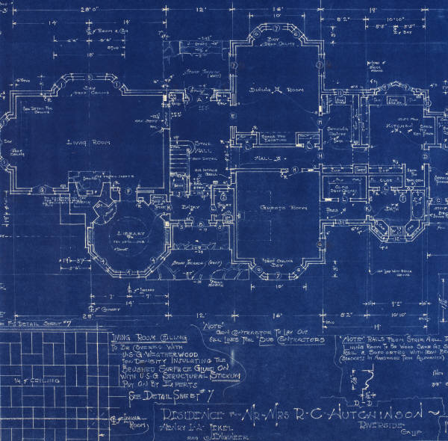
Key Features for Portfolios
Artifacts

Slide 6
Key Features for Portfolios
Rubric—the structure and specifications for evaluation of work
Self-reflection—How did I do? What do I think about this? How does what I learned apply to my goals?

Slide 7
Adding the ‘E’ to Portfolio
Portability
Sharing
Customized just-in-time views

Slide 8
A few words on E-Portfolio Development

Slide 9
The Marketplace Today

Slide 10
OSPI

Slide 11
Web 2.0 Tools

Slide 12
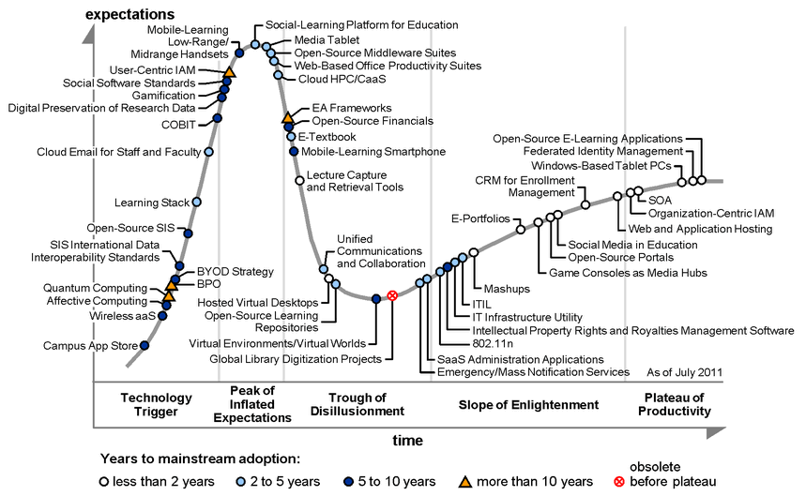
Adoption and Success?
Gartner Hype Cycle in Higher Education, 2011, © Gartner, Inc.

Slide 13
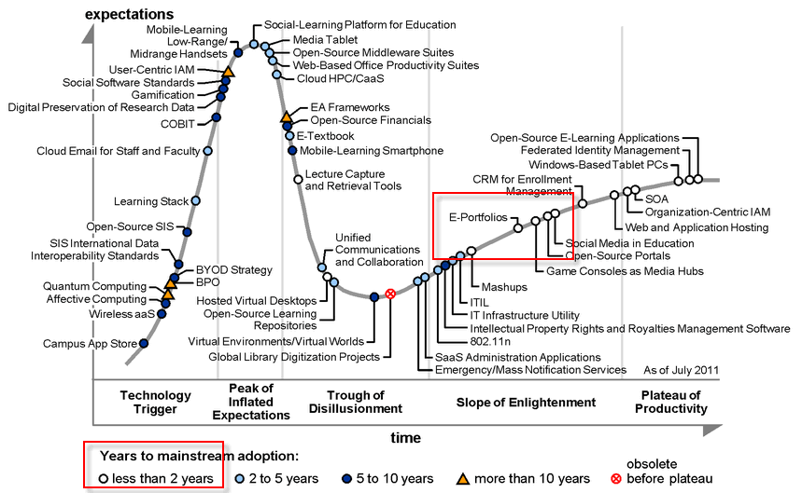
Adoption and Success?
Gartner Hype Cycle in Higher Education, 2011, © Gartner, Inc.

Slide 14
Our Experience in “Becoming a Professional”
Enhance students’ understanding of the nature and challenges facing the legal profession in a time of significant change.
Develop identified skills not generally taught in other law school classes, using both cognitive and skill-development strategies.
Encourage students to engage in reflection and shape their professional paths based on deeper understandings of their personal and professional identities
Encourage students to understand how their personal values (along with professional values) can shape their future trajectories

Slide 15
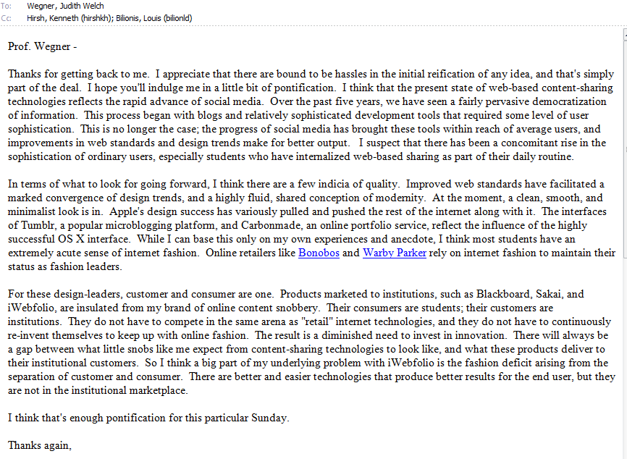
Challenges

Slide 16
Planning for Fall 2012
Continue with iWebfolio?
Use Throughout Semester

